Slide 1
Order Placement Training
Step-by-step instructions for ordering eyeglasses online
For Review With:
California, Kentucky, Maine, North Carolina, Oklahoma and Virginia Agencies
Document Date:
June 28, 2016

Slide 2
Table of Contents
About MarvelOptics.com
About New Eyes
Service Overview
Order Process
Contact Information

Slide 3
About MarvelOptics.com & New Eyes for the Needy

Slide 4
About MarvelOptics.com
Access to vision is a fundamental right and should not be a financial burden on anyone. Keeping in mind the countless hardworking families, students, young professionals and seniors, at Marveloptics.com our goal is to bring you cheap prescription eyeglasses with the highest quality.
Our core principles extend beyond bringing you discounted glasses. We work hard to ensure quality and procure the best frames and lenses. Each prescription eyeglass order is vigorously tested and retested to meet your expectations. Furthermore, we take pride in making your online eyeglass shopping experience as comfortable as possible. You will have easy access to our highly trained opticians and friendly customer service staff to address your questions.
Customer satisfaction is our top priority. If you do not like the discount prescription glasses you purchased we back each order with our 365 day, 100% money back guarantee. We promise that when you buy eyeglasses online at Marveloptics.com, you will be amazed by our quality and remarkable service.

Slide 5
About New Eyes
New Eyes for the Needy, a 501(c)(3) not-for-profit organization founded in 1932, empowers children and adults in the United States and overseas with the improved vision they need to pursue a better quality of life for themselves and their communities.
New Eyes operates primarily through volunteer efforts and is overseen by a Board of Trustees. Recycling programs, including the sorting, testing and packaging of used eyeglasses, are operated by hundreds of adult and student volunteers.
11 million people in the United States struggle with uncorrected vision and have no resources to buy eyeglasses.
New Eyes also purchases eyeglasses for needy residents of the U.S. We help when no one else can.

Slide 6
Service Overview

Slide 7
Unparalleled Experience
Web & Mobile Site
Agencies will have easy access to our site from a PC, tablet, or mobile device any time.
Returns/Exchanges
Your clients will be able to easily return or exchange their purchases If they’re not 100% satisfied.
Order Fulfillment
We will handle everything – order fulfillment, quality control, returns, and patient support.
Frame Options
Your clients will have access to a variety of styles and sizes, including kids.
Customer Support
Agencies will receive excellent customer service from certified opticians. Satisfaction is our top priority.
Ease of Use
Agencies will have dedicated account rep to address any questions and concerns
Virtual Try On
Your clients will be able to find perfect style and fit using the cutting edge Virtual Try On technologies.

Slide 8
Step-By-Step Ordering Process

Slide 9
Step 1: Create New Account

Slide 10
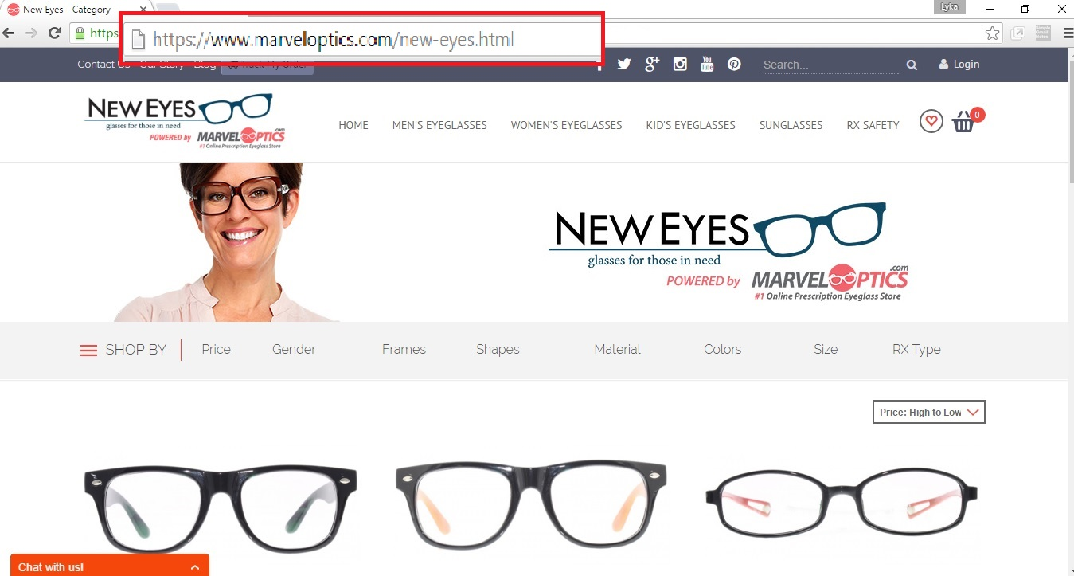
Go to www.marveloptics.com/new-eyes.html

Slide 11
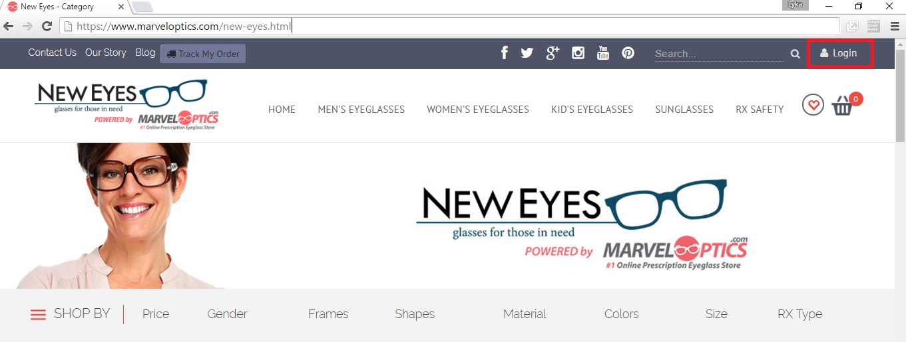
2. Click “LOGIN / REGISTER” link on the top right side of the webpage

Slide 12
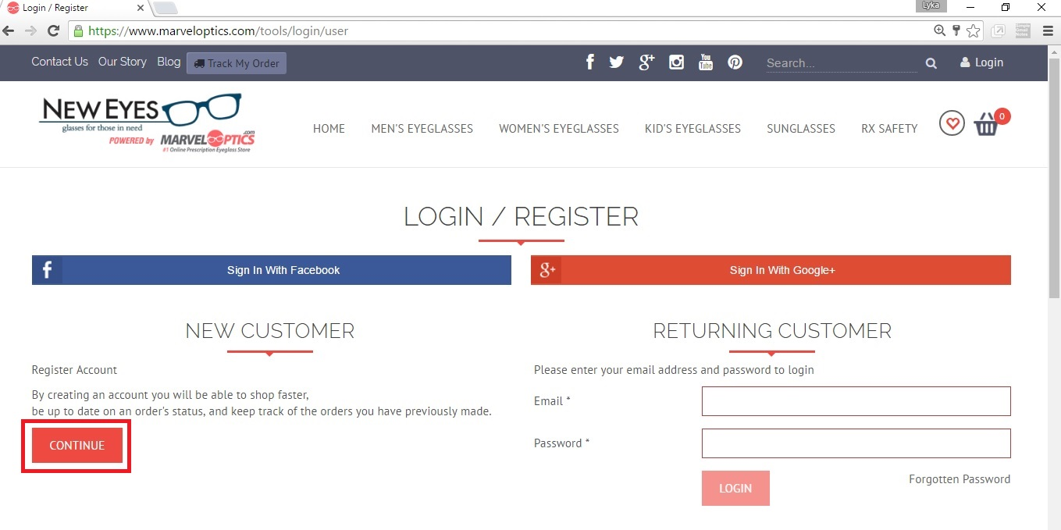
3. Click Continue Under New Customer section on the left side

Slide 13
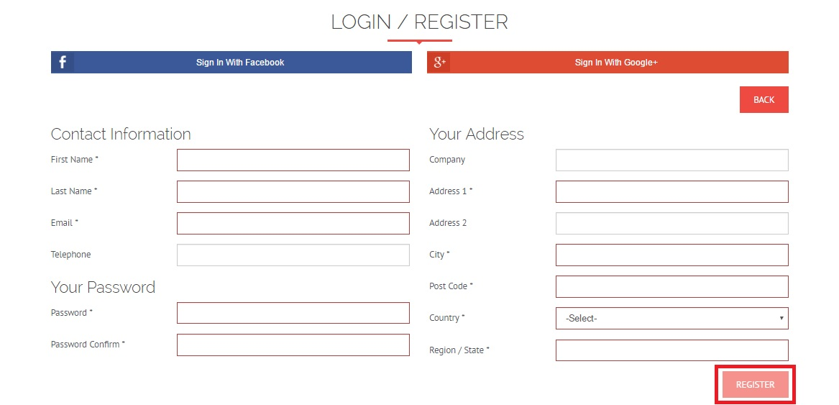
4. Enter Contact Information, Address, and New Password. An automated email will be sent to you as confirmation with your account details .

Slide 14
Step 2: Start Shopping

Slide 15
1. Go to www.marveloptics.com/new-eyes.html

Slide 16
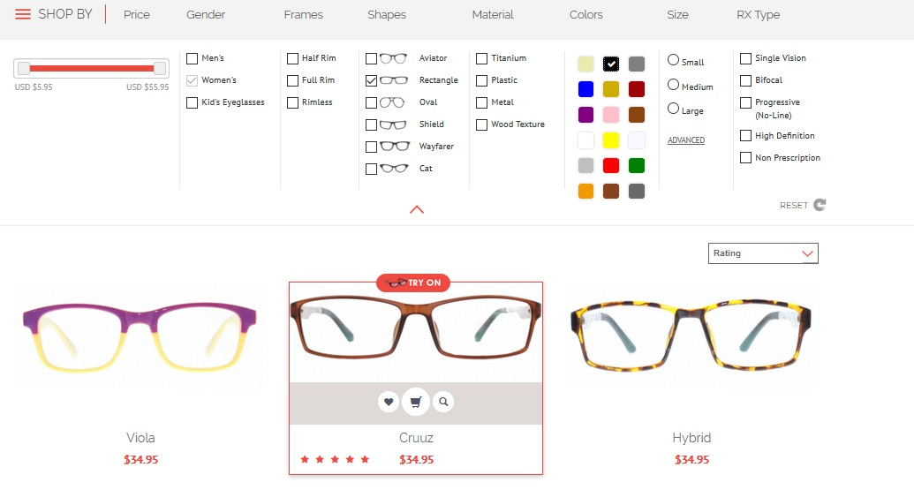
2. Use the filter tool to select frames by gender and size. Select a frame of your clients choice.

Slide 17
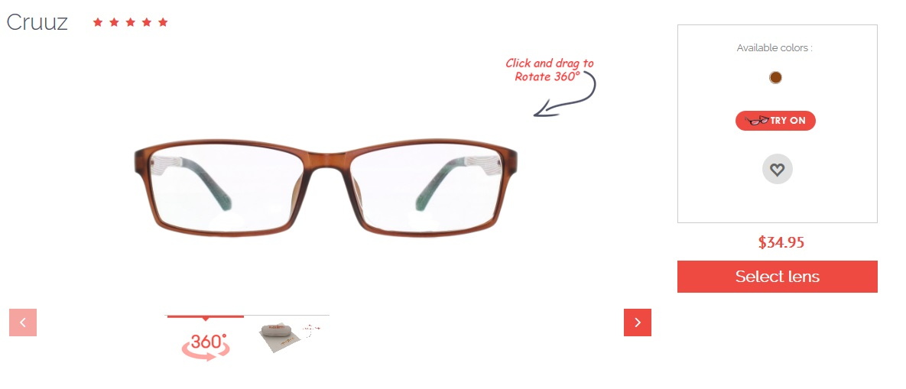
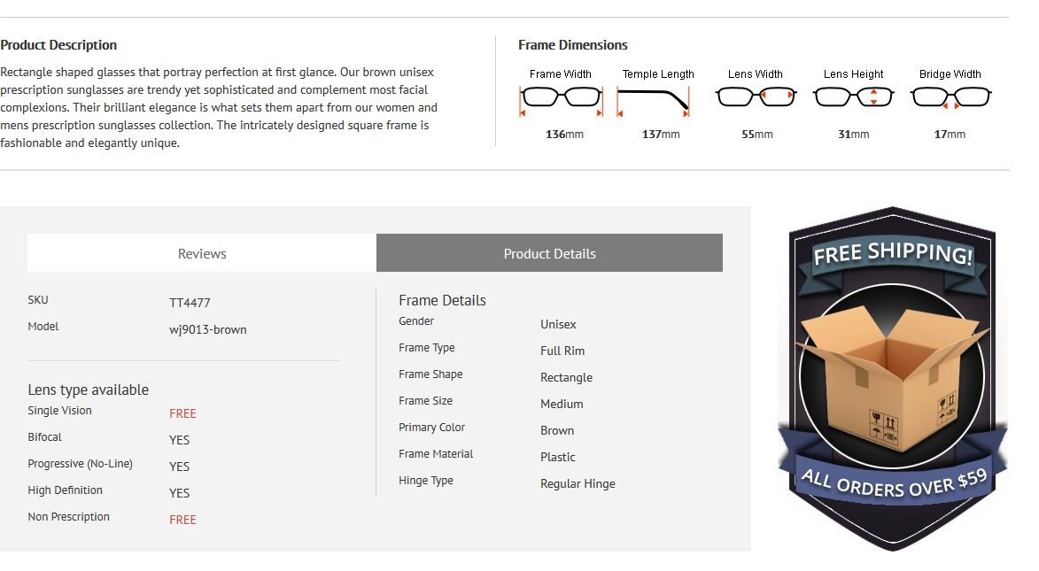
3. The Product Detail Page – allows you to review frame information with a 360 degree view of the frames

Slide 18
4. You can help the customer by also using the “Try On” feature which will allow customer to visualize how the frame will look and fit on them.

Slide 19
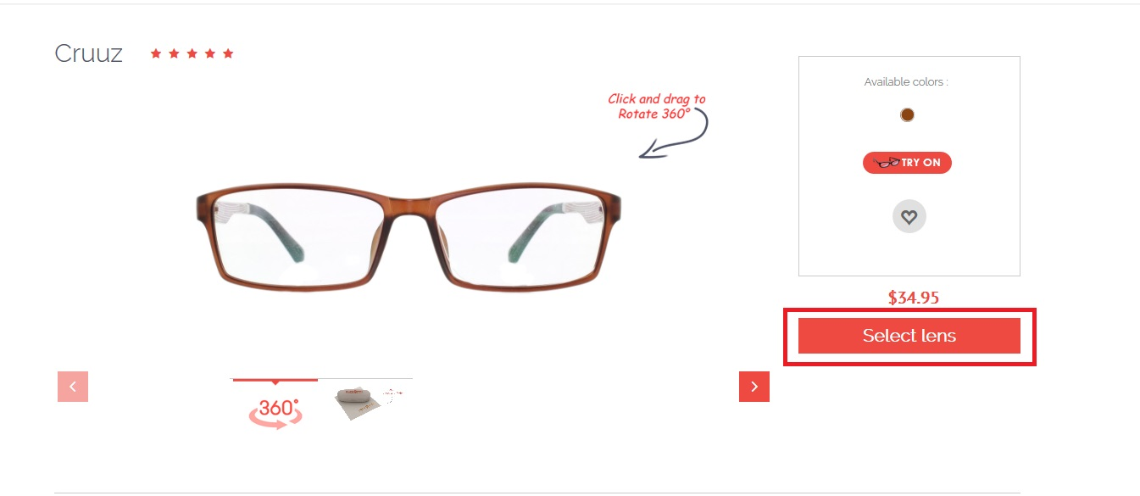
5. Click “Select Lens” once your client has finalized his or her preference.

Slide 20
Step 3: Customize Lens

Slide 21
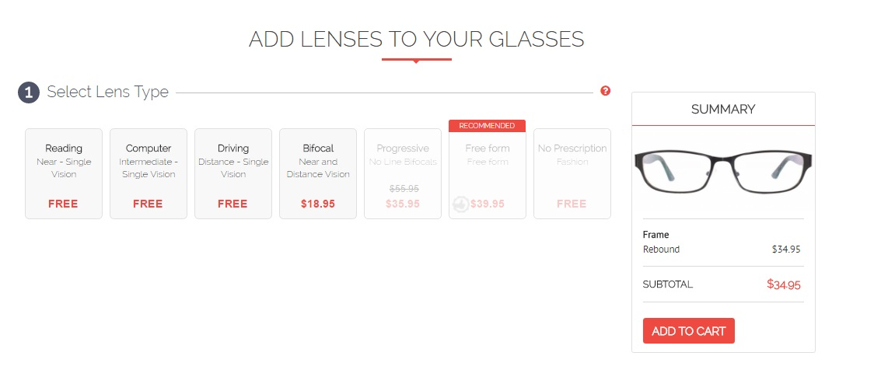
Identify if client needs single vision or bifocal lens.
This can be found on customer’s prescription card. Typically, if there is a number under “ADD” column, the customer requires bifocal lens.

Slide 22
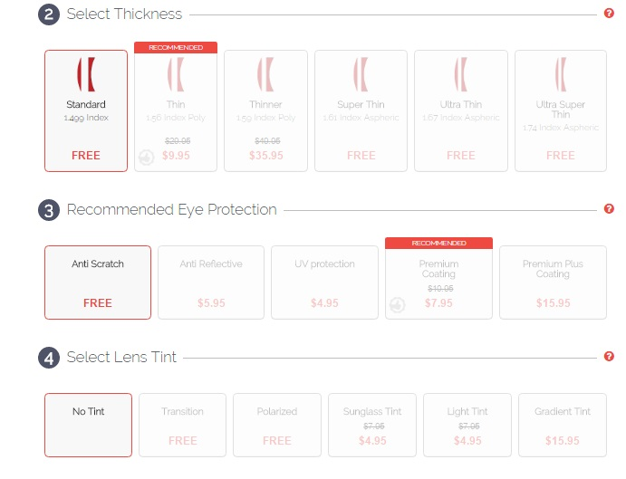
2. Select Standard Thickness and Anti-Scratch coating and No Tint.

Slide 23
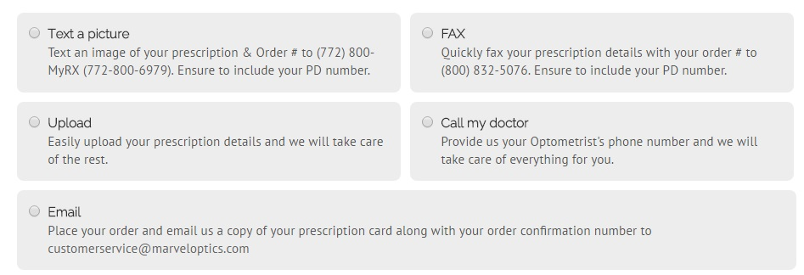
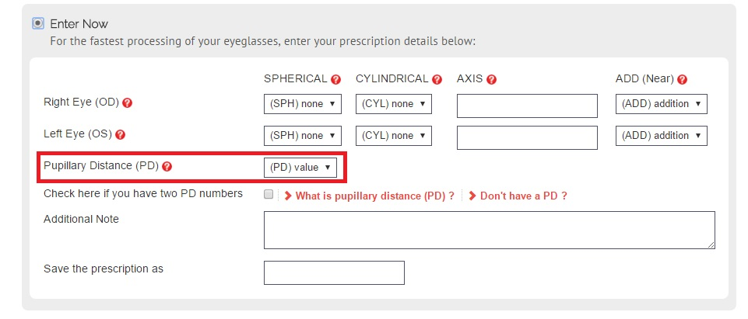
3. Provide client’s prescription
-there are multiple ways you can provide this. You can either : fax, text, email, upload it, ask us to call client’s doctor or you can enter it right away.
*Note that PD is a required field. If customer does not have a PD value, consult with optician if possible.
*Upload or entering of prescription will create faster processing time.

Slide 24
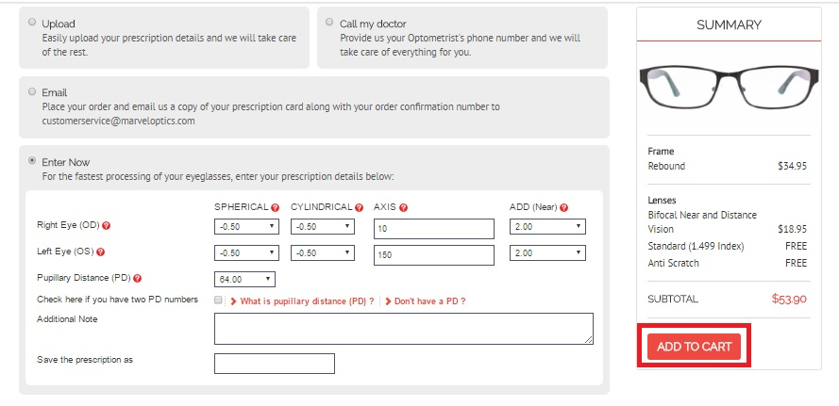
4. Review the order and prescription and if everything is ok then click “ADD to Cart”.

Slide 25
Step 4: Place customer order

Slide 26
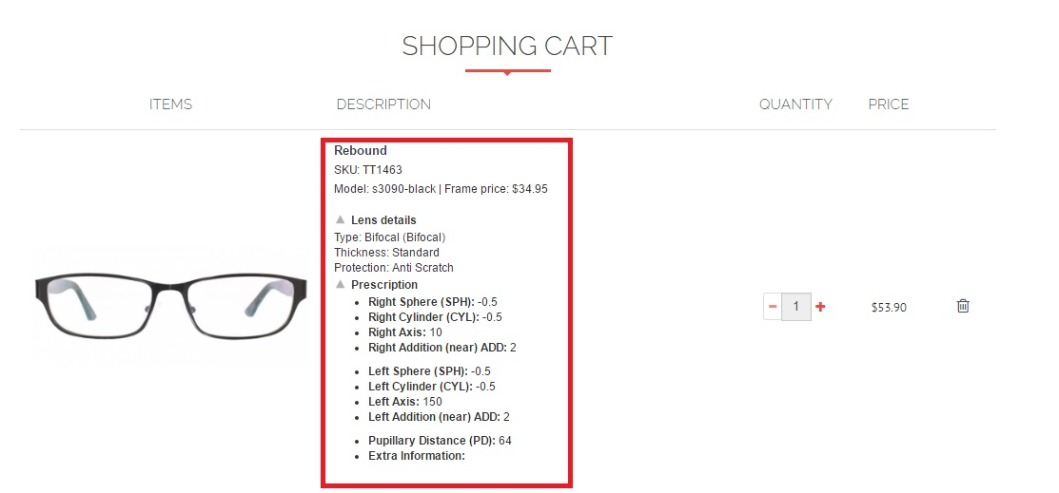
1. Review your order to ensure accuracy in the cart page. If everything looks good, click “Checkout”.

Slide 27
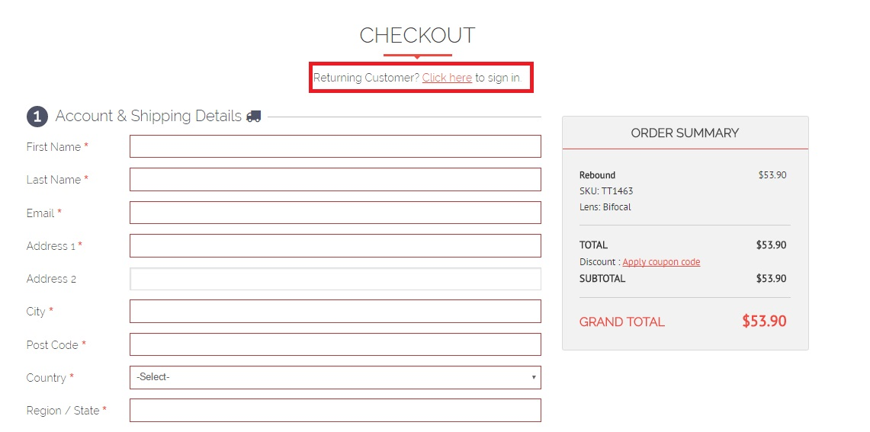
2. Click on the log-in link if you are not yet logged into your account.

Slide 28
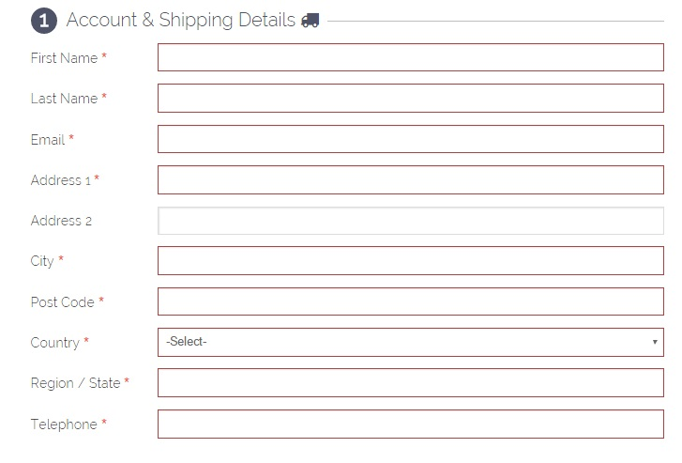
3. Enter your client’s shipping information
- alternatively, you can enter the agency address if client wants to pick up order from agency location.

Slide 29
4. Choose “Enter Billing address” and enter your agency’s information
* This is for us to be able to trace what agency the order is associated with. Your agency won’t be billed in any way. The voucher covers all costs of the order including shipping fees.

Slide 30
5. Select the standard shipping option under the “Shipping Method” section.
Please note that selecting the express shipping option will not expedite your clients order. The express shipping option is not available.
All order will take 10-14 days to be delivered. Please notify your clients accordingly.

Slide 31
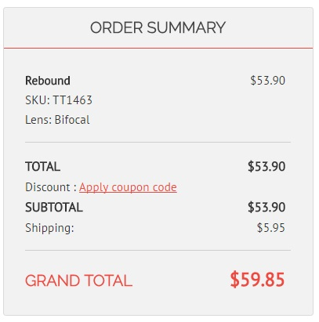
6. Review your order in the “Order Summary” section
-Please note that the price reflected in the order summary is irrelevant and will not impact the use of the voucher provided by New Eyes.

Slide 32
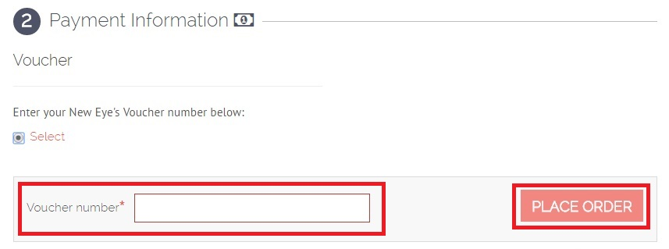
7. Enter New Eyes voucher number under the “Payment Method” section then click “Place Order”

Slide 33
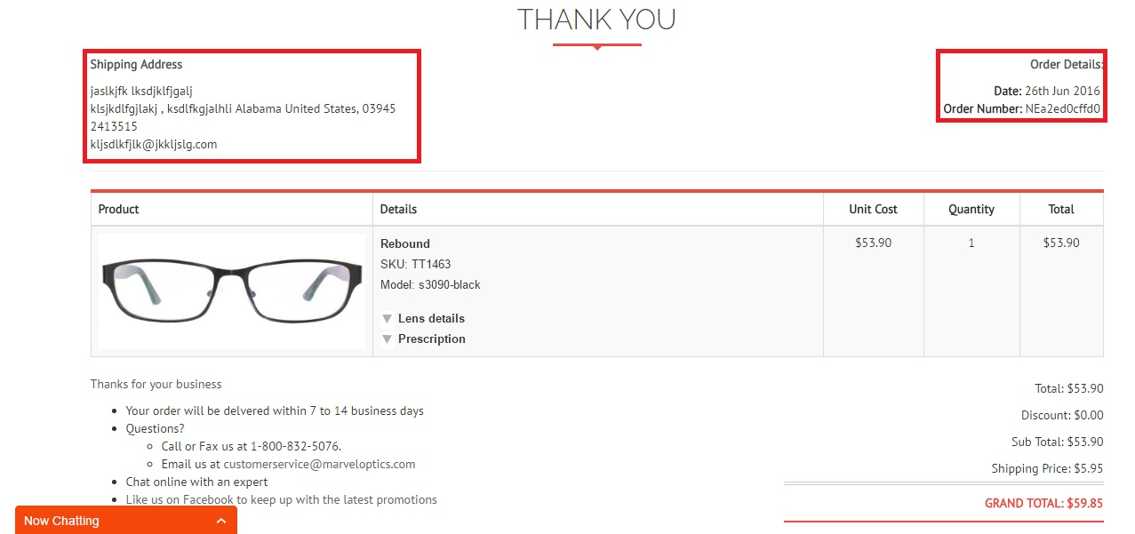
8. Order Complete - Verify order details such as shipping information and then provide a copy of order number to customer. An automated email will be sent to your agency highlighting order details.

Slide 34
Contact Information

Slide 35
Contact Marvel Optics
Three easy ways to contact us
Chat Online with an expert: Connect instantly with one of our experts. We are always available during working hours to assist you.
Email us: customerservice@marvelOptics.com Write to us today using the form on the website, and we will respond to your query within 24 hours with a detailed answer
Call us: Talk to a representative who will quickly address any questions you may have. The number to reach us is 1-800-832-5076.
Please fax any documentation to 1-800-832-5076

